Slide 1

Information Security Engr. Syed Rizwan

Slide 2
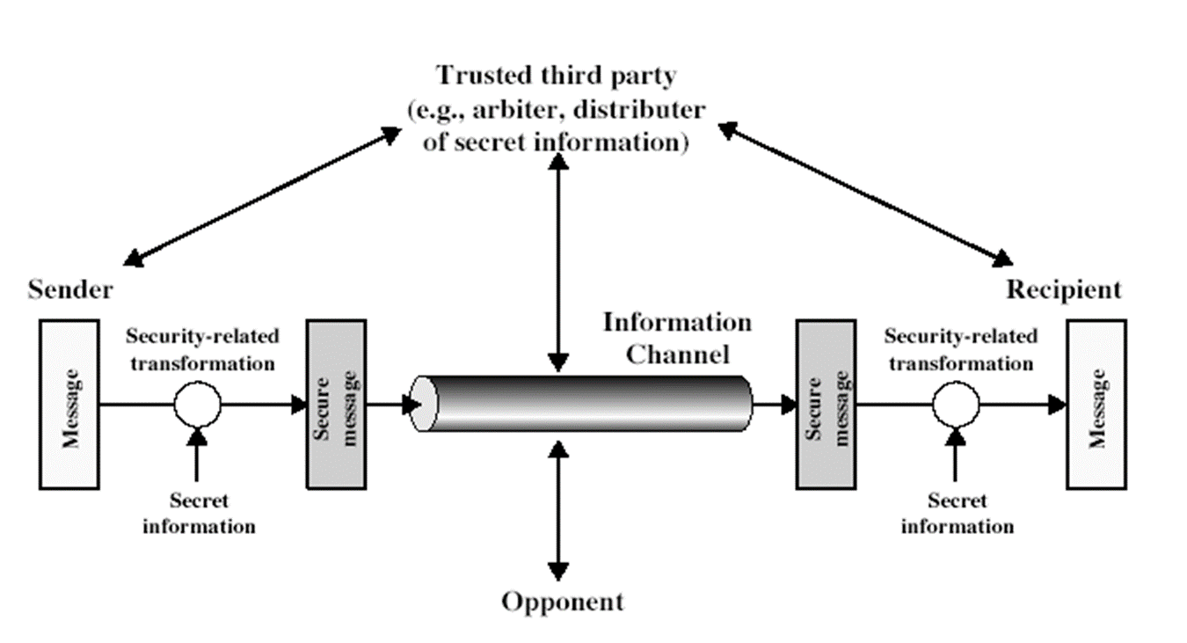
OSI Security Architecture
Model for Network Security

Slide 3
Cryptography
The word ‘Cryptography’ was coined by combining two Greek words, ‘Krypto’ (means Hidden) and ‘Graphene’ (means Writing)
The art of protecting information by transforming it into an unreadable format is known as Cryptography

Slide 4
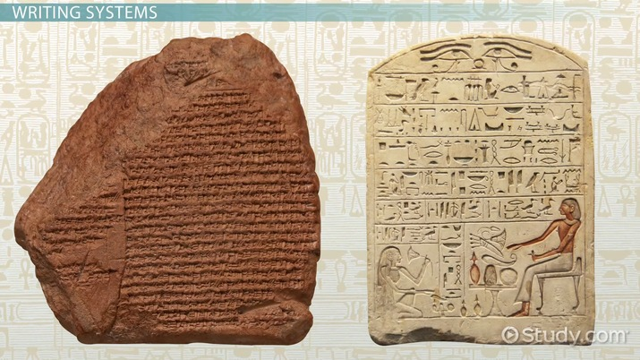
Origin of Cryptography
Human being from ages had two inherent needs
to communicate and share information and
to communicate selectively.

Slide 5
Origin of Cryptography
These two needs gave rise to the art of coding the messages in such a way that only the intended people could have access to the information.
Unauthorized people could not extract any information, even if the scrambled messages fell in their hand.

Slide 6
Origin of Cryptography
The art of cryptography is considered to be born along with the art of writing.
As civilizations evolved, human beings got organized in tribes, groups, and kingdoms.
This led to the emergence of ideas such as power, battles, supremacy, and politics.

Slide 7
Origin of Cryptography
These ideas further fueled the natural need of people to communicate secretly with selective recipient which in turn ensured the continuous evolution of cryptography as well.
The roots of cryptography are found in Roman and Egyptian civilizations.

Slide 8
The Oldest Cryptographic Techniques
The first known evidence of cryptography can be traced to the use of ‘Hieroglyph’.
Some 2000 BC, the Egyptians used to communicate by messages written in Hieroglyph.
This code was the secret known only to the scribes who used to transmit messages on behalf of the kings.

Slide 9
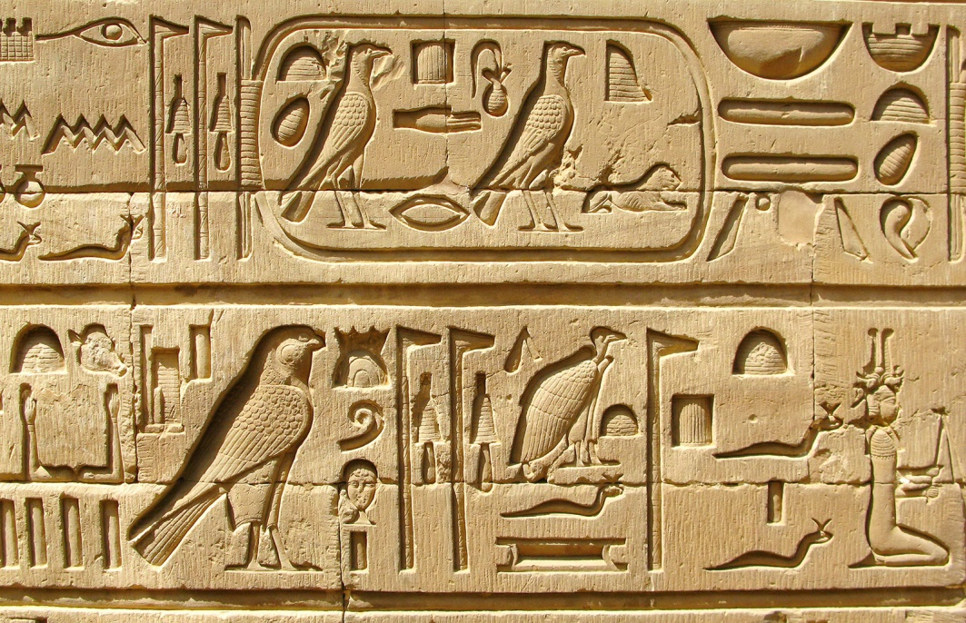
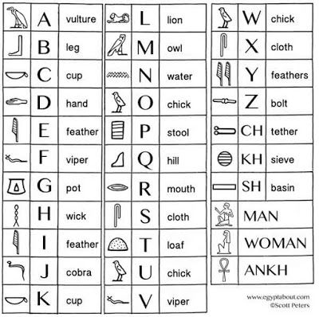
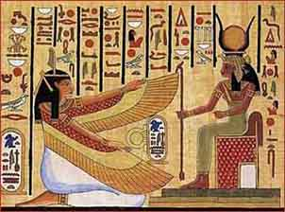
The Oldest Cryptographic Techniques
4000 years earlier Egyptians Hieroglyph

Slide 10
The Oldest Cryptographic Techniques
Later, the scholars moved on to using simple mono-alphabetic substitution ciphers during 500 to 600 BC.
This involved replacing alphabets of message with other alphabets with some secret rule.
This rule became a key to retrieve the message back from the garbled message.

Slide 11
The Oldest Cryptographic Techniques
The earlier Roman method of cryptography, popularly known as the Caesar Shift Cipher, relies on shifting the letters of a message by an agreed number, the recipient of this message would then shift the letters back by the same number and obtain the original message.

Slide 12
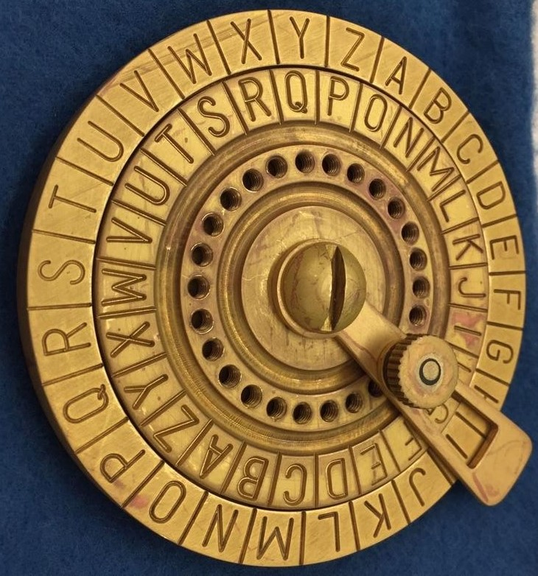
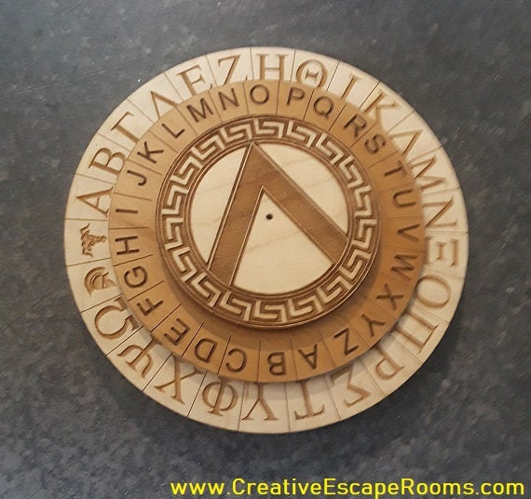
The Oldest Cryptographic Techniques
2500 years earlier Roman Caesar Shift Cipher

Slide 13
Some Basic Terminologies
Plaintext - Original message
Ciphertext - Coded message
Cipher - Algorithm for transforming plaintext to ciphertext
Key - Information used in cipher known only to sender/receiver
Encipher (Encrypt) - Converting plaintext to ciphertext
Decipher (Decrypt) - Recovering ciphertext from plaintext
Cryptography - Study of encryption principles/methods
Cryptanalysis (Codebreaking) - Study of principles/ methods of deciphering ciphertext without knowing key
Cryptology - field of both cryptography and cryptanalysis

Slide 14
Cryptographic Dimensions
Cryptographic systems are characterized along three independent dimensions
The type of operations
The number of keys
The processing ways

Slide 15
Cryptographic Dimensions
The type of operations
All encryption algorithms are based on two general principles:
substitution, in which each element in the plaintext (bit, letter, group of bits or letters) is mapped into another element,
transposition, in which elements in the plaintext are rearranged.
Sometimes, product systems also used that involve multiple stages of substitutions and transpositions.

Slide 16
Cryptographic Dimensions
The number of keys
If both sender and receiver use the same key, the system is referred to as symmetric, single-key, secret-key, or conventional encryption.
If the sender and receiver use different keys, the system is referred to as asymmetric, two-key, or public-key encryption.

Slide 17
Cryptographic Dimensions
The processing ways
A block cipher processes one input block of elements at a time, producing an output block for each input block.
A stream cipher processes the input elements continuously, producing output element continuously, as it goes along.

Slide 18
Symmetric Encryption Model

Slide 19
Asymmetric Encryption Model (a)

Slide 20
Asymmetric Encryption Model (b)

Slide 21
Requirements
Two requirements for secure use of symmetric encryption:
a strong encryption algorithm
a secret key known only to sender / receiver
Mathematically have:
Y = E_{K}(X)
X = D_{K}(Y)
Assume encryption algorithm is known
Implies a secure channel to distribute key

Slide 22
Cryptanalytic Attacks
Ciphertext only
only know algorithm & ciphertext, is statistical, know or can identify palaintext
Known plaintext
know/suspect plaintext & ciphertext
Chosen plaintext
select plaintext and obtain ciphertext
Chosen ciphertext
select ciphertext and obtain plaintext
Chosen text
select plaintext or ciphertext to encrypt/decrypt

Slide 23
Questions ?

